Slide 1
Ch6 Normalization Exercise
As usual, please ignore problem numbers and other oddly bulleted items ☺

Slide 3
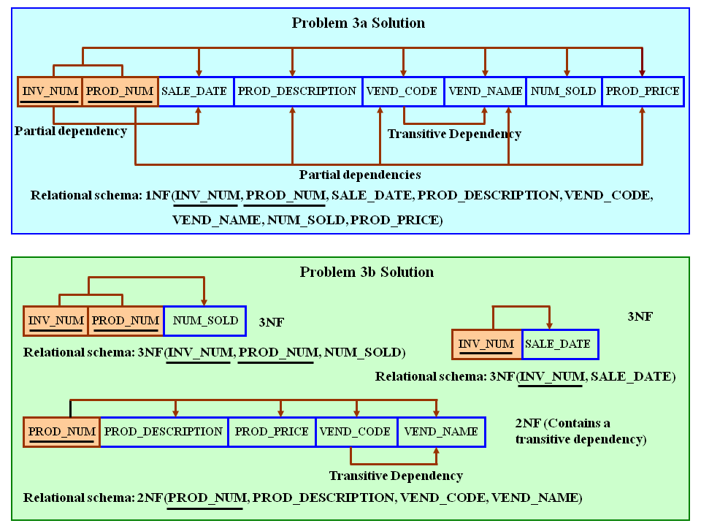
Figure P6.3a The Dependency Diagrams for Problems 3a and 3b

Slide 4
Remove all transitive dependencies, write the relational schema, and draw the new dependency diagrams. Also identify the normal forms for each table structure you created.
To illustrate the effect of Problem 3's complete decomposition, we have shown Problem 3a's dependency diagram again in Figure P6.3c.
Figure P6.3c The Dependency Diagram for Problem 3c

Slide 5
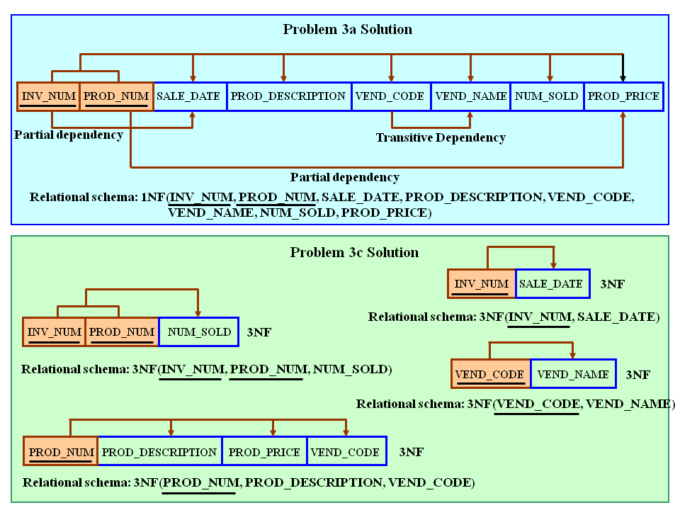
Remove all transitive dependencies, write the relational schema, and draw the new dependency diagrams. Also identify the normal forms for each table structure you created.
To illustrate the effect of Problem 3's complete decomposition, we have shown Problem 3a's dependency diagram again in Figure P6.3c.
Figure P6.3c The Dependency Diagram for Problem 3c

